Slide 1

Waveform Generator
Group 3
Tham Seng Joe
Ong Hon Lin

Slide 2

Problem Statements
Growing need for a versatile and user-friendly waveform generator application
Lacking said application that can cater to hobbyist

Slide 3

Problem Solution
Create an application that is intuitive and easy to navigate
Create an application for generation of basic waveforms

Slide 4
Objectives
Allow users to generate multiple waveforms
Allow users to input results from .CSV file
Allow users to export result to .CSV file
Allow users to compare waveforms

Slide 5
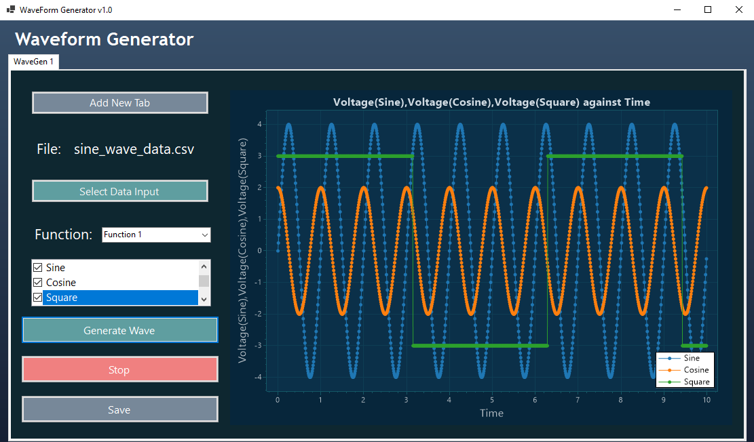
Project Overview
Function 1: Graph plots

Slide 6
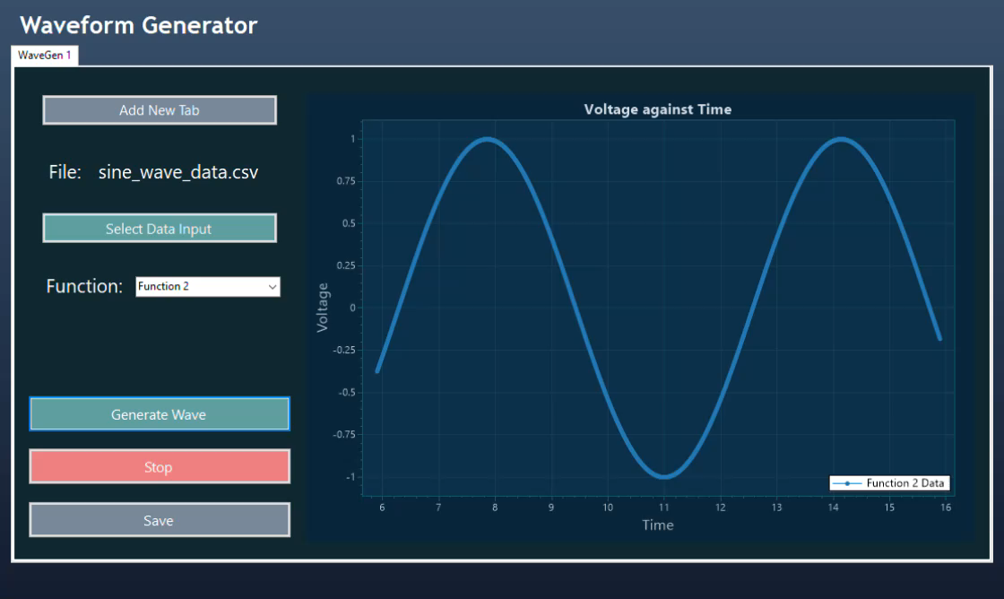
Project Overview
Function 2: Dynamic plots

Slide 7
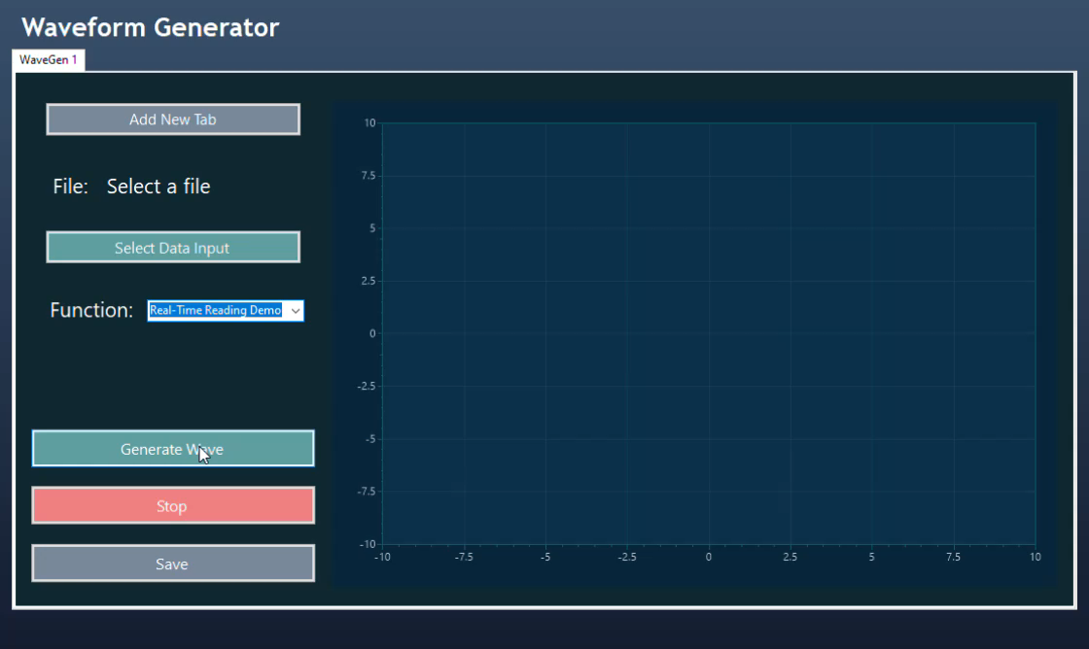
Project Overview
Function 3: Random Real-Time Reading plots

Slide 8
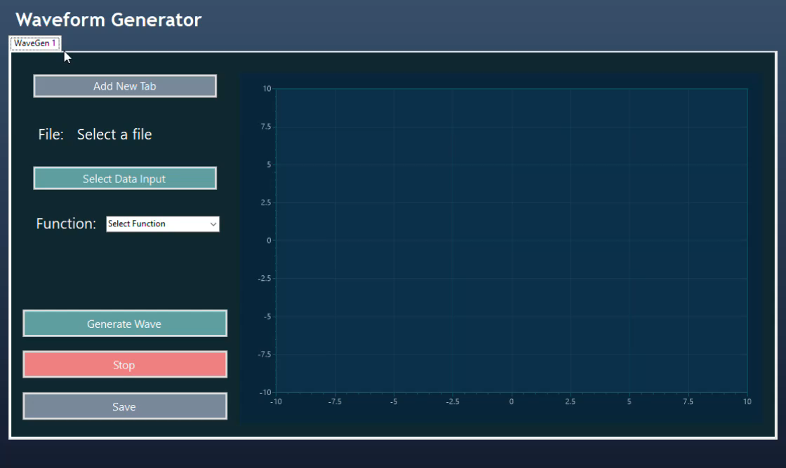
Project Overview
New Tab

Slide 9

Results & Discussion
Added multiple features for users to view graphs in varying ways
Added features to import and export graph data

Slide 10
Conclusion
Created an intuitive and user-friendly application
Created an application to generate basic waveforms

Slide 11
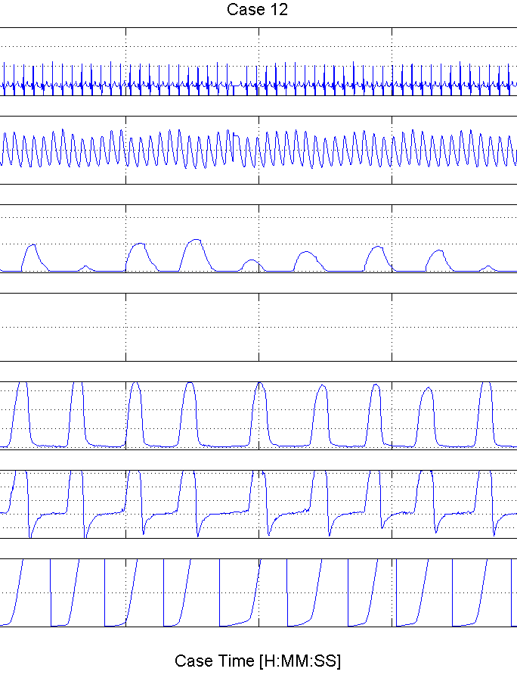
Future Improvements
Allow users to determine own parameters (eg. Time, Amplitude)
Allow gathering of live data from an active machine
This Photo by Unknown author is licensed under CC BY-NC.

Slide 12
Thank you

